Slide 1
NoSql –Databases
COURSE 9: Databases

Slide 2
Big Data x-V’s

Slide 3
Relational database vs BigData
Structured data vs semi-structured data (example graph data, key-value storages)
join: execution time increase, relational databases more expressive.
Data from a single enterprise vs data from multiple sources
BigData requires high degree of parallelism (storage and processing)
Replicas and Sharding (key-value storage systems and documents stores)

Slide 4
Big data attributes
VOLUME
VELOCITY
VARIETY
VERACITY
VALUE
Huge amount of data, even the number of V’ for big data is increasing.
IoT devices, cloud data, mobile traffic etc.

Slide 5
Big data attributes
VOLUME
VELOCITY
VARIETY
VERACITY
VALUE
Speed at which data is added/modified.
Rapid change of data model.
Exponential growth
--175 zettabytes by 2025.

Slide 6
Big data attributes
VOLUME
VELOCITY
VARIETY
VERACITY
VALUE
Different sources
Structured (DBMS), semi-structured data (json, xml, csv files), unstructured data (images, videos, text files, audio files etc.).

Slide 7
Big data attributes
VOLUME
VELOCITY
VARIETY
VERACITY
VALUE
Data accuracy and credibility.
Extract value using data analytics.
Transform data into business.

Slide 8
BASE
consitency model

Slide 9
BASE
Basic Availability
Soft-state
Eventual consistent
BASE advantages: availability, scale and resilience.
(examples: social media apps, online services)
Database appears to work most of the time.

Slide 10
BASE
Basic Availability
Soft-state
Eventual consistent
Nodes may not be in consistent state.

Slide 11
BASE
Basic Availability
Soft-state
Eventual consistent
Consistency is achieved at some later point.
Data will be consistent in the future (but not at read time) or
Certain past snapshots are consistent.

Slide 12
CAP theorem

Slide 13
CAP theorem
No distributed database can guarantee more than two of the following:
Consistency: read the most recent write or an error,
(linearizable consistency) once an operation is complete,
it is visible to all nodes.
eventual consistency
Availability: every request receives a non-error response
Partition tolerance: system operates despite arbitrary number of messages being lost

Slide 14
CAP theorem
No distributed database can guarantee more than two of the following:
Consistency: read the most recent write or an error,
Availability: every request receives a non-error response
non-failing nodes receiving requests returns a response
high availability
Partition tolerance: system operates despite arbitrary number of messages being lost

Slide 15
No distributed database can guarantee more than two of the following:
CP: sacrifice availability, consistency and partition tolerance
AP: sacrifice consistency, availability and partition tolerance
CA: sacrifice partition tolerance, consistency and availability
Alternative: PACELC

Slide 16
A
RDBMS,
Neo4J
Cassandra, DynamoDB, CouchDB
C
P
MongoDB, HBase,
Spanner, Redis

Slide 17
CAP Theorem
MongoDB CP datastore.
In each replica set one primary nodes receives write operations.
Secondary nodes replicate primary node’s operations.
If case of failure of the primary node, a secondary node replace it (node with the most recent log).
The cluster becomes available only when all the secondary nodes replicate the primary node.

Slide 18
CAP Theorem
Cassandra AP datastore.
Eventually consistent: it’s not guarantee that all replicas have the same data.
Consistency level: number of replicas that needs to respond to a read/write operation.
ONE: closest replica
QUORUM: synchronize → majority.

Slide 19
Consistency levels
Strict consistency: global clock, all reads seen instantaneously by all processors.
Sequential consistency: global order on write operations.
Atomic consistency or linearizability: global order on operations that do not overlap in time.
Casual consistency: global order on related write operations.
Eventually consistent: if there are no writes for a period of time that is system dependent, every node will “see” the value of the last write.

Slide 20
Graph databases

Slide 21
Graph databases
Flexible, easy to add new types of data, new relationships.
Support for big data storage in the order of petabytes (10¹⁵).
Suitable for complex, unstructured data.
High performance querying and ACID transactions support.
Agile, database evolve with the business/application requirements.

Slide 22
Graph databases
Specific query language and efficient implementations for query execution. (example Cypher query language, AQL - ArangoDB Query Language)
Support for graph visualization.
Examples: Neo4J, OrientDB, Dgraph, ArrangoDB

Slide 23
Neo4J

Slide 24
Neo4J
open-source graph database.
implemented in Java
Support for graph visualization.
Applications: recommendation systems, fraud detection, knowledge graphs, IoT etc.

Slide 25
Neo4J
Cypher query language
HTTP API
Index support using Apache Lucence.

Slide 26
Graph databases
entities in the graph, can hold attributes.
each node has a label identifying node’s role.
NODES

Slide 27
Graph databases
entities in the graph, can hold attributes.
each node has a label identifying node’s role.
provide semantic connections between two node entities.
each relationship has a type, a start node and end node.
can be navigated in both directions
NODES
RELATIONSHIPS

Slide 28
Graph databases
entities in the graph, can hold attributes.
each node has a label identifying node’s role.
provide semantic connections between two node entities.
each relationship has a type, a start node and an end node.
can be navigated in both directions
properties of nodes or relationships.
An attribute is given by a key-value pair.
Relationship attributes are typically quantitative properties (weights, costs, ratings etc.).
NODES
RELATIONSHIPS
ATTRIBUTE

Slide 29
Graph databases
CREATE (TheMatrix:Movie {title:'The Matrix', released:1999, tagline:'Welcome to the Real World’})
CREATE (Keanu:Person {name:'Keanu Reeves', born:1964})
CREATE
(Keanu)-[:ACTED_IN {roles:['Neo']}]->(TheMatrix),
(Carrie)-[:ACTED_IN {roles:['Trinity']}]->(TheMatrix),
(LillyW)-[:DIRECTED]->(TheMatrix)
title, tagline, released, roles.
labels: Movie, Person, ACTED_IN, DIRECTED
NODES
RELATIONSHIPS
ATTRIBUTE

Slide 30
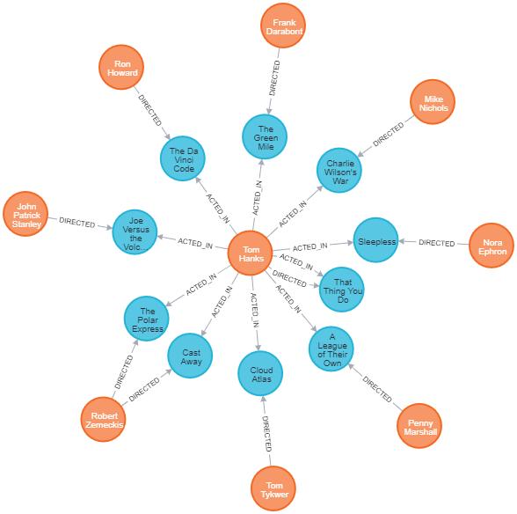
Graph databases
WITH TomH as a
MATCH (a)-[:ACTED_IN]->(m)<-[:DIRECTED]-(d)
RETURN a,m,d LIMIT 10;
MATCH (tom:Person {name: 'Tom Hanks’})
-[:ACTED_IN]->(:Movie)<-[:ACTED_IN]-(coActor:Person) RETURN coActor.name

Slide 31
Paxos algorithm

Slide 32
Paxos
Google Spanner, Cassandra, Neo4J etc.
One run → accepted value. O(n²), n nodes
One node may take one or more roles:
acceptor, proposer, learner [1]
Nodes may rejoin after failure, no malicious behavior, fault tolerant
Nodes remember what they accept (not ensured in all variants).

Slide 33
Paxos
Proposers: send a unique internal id request PREPARE(R_id) to acceptors.
If the id is not accepted, he will send another R_id (1, 3, 5 etc.)
Acceptors: When an acceptor accepts a REQUEST with id: R_id
acceptor promise to ignore all request with R_id’ < R_id
acceptor send a PROMISE id P_id to all proposers.
or
ignore the id if it already send a promise R_id’’ with R_id’’ > R_id.
Proposers: When a proposer receives a majority of promises P_id
proposer will pick a value and send ACCEPT-REQUEST,
a pair (P_id, value) to acceptors.

Slide 34
Paxos
Acceptors: When an acceptor receives ACCEPT-REQUEST(P_id, value)
ignore the id if it already made a promise P_id’ with P_id’ > P_id.
or
acceptor send message ACCEPT(P_id, value) to all learners/proposers.
Learners:
If a majority of acceptors accept a request consensus has been reached.
(N > 2f + 1)
No ACCEPT REQUEST with lower ID will be accepted .
No ACCEPT REQUEST with higher ID and a different value will be accepted .

Slide 36
Proposers: send a unique internal id request PREPARE(R_id) to acceptors.
If the id is not accepted, it will send another R_id (1, 3, 5 etc.)

Slide 38
Acceptors: When an acceptor accepts a REQUEST with id: R_id
acceptor promise to ignore all request with R_id’ < R_id
acceptor send a PROMISE id P_id to all proposers

Slide 39
Proposer: receives a majority of promises P_id
proposer will pick value and send ACCEPT-REQUEST,
a pair (P_id, value) to acceptors.

Slide 40
Acceptors: acceptor receives ACCEPT-REQUEST(P_id, value)
ignore the id if it already made a promise P_id’ with P_id’ > P_id.
or
acceptor send a ACCEPT(P_id, value) to all learners/proposers.

Slide 41
Acceptors: ignore the id if it already send a promise
R_id’’ with R_id’’ > R_id.

Slide 42
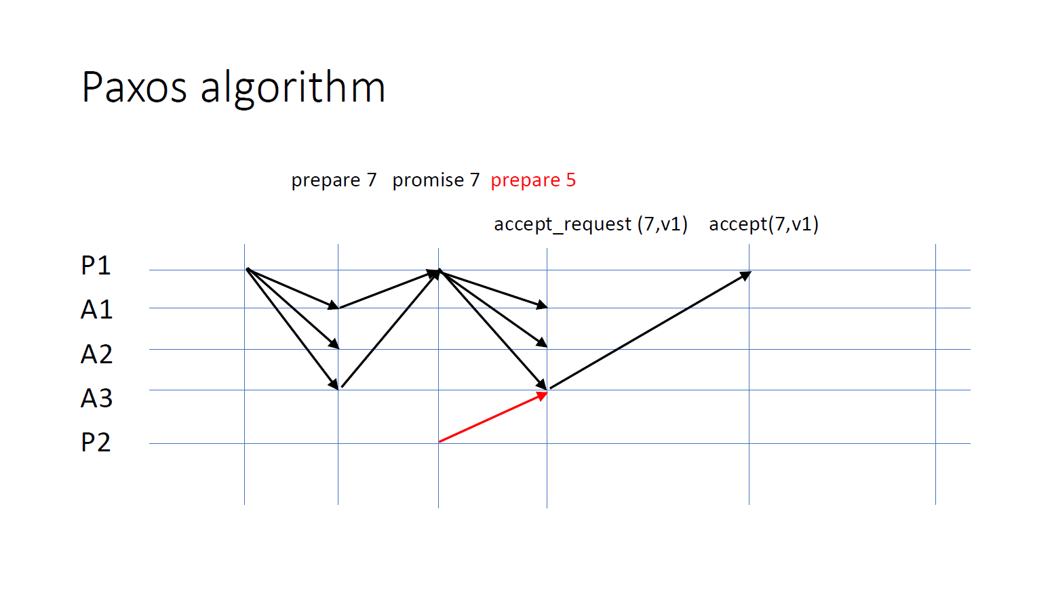

Slide 43
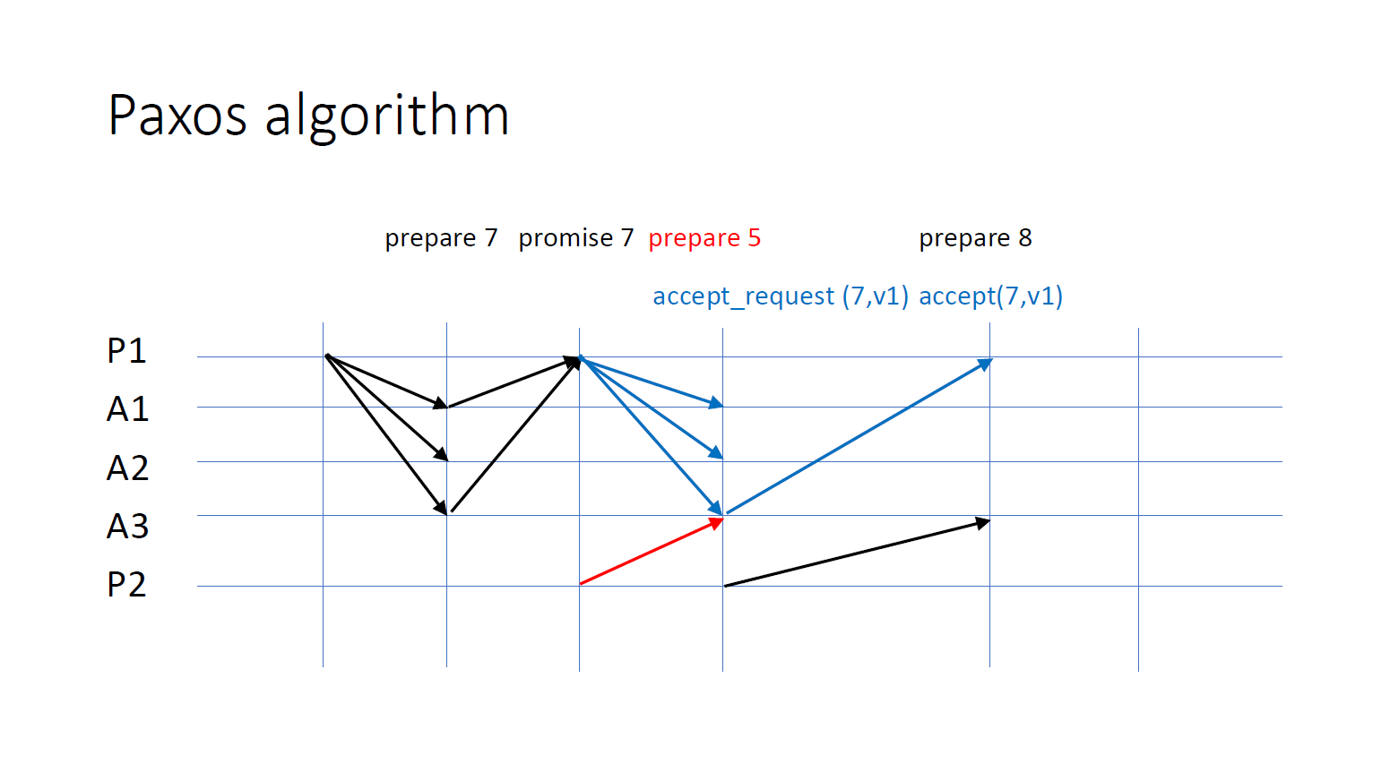
Acceptors: send a ACCEPT(P_id, value) to all learners/proposers.
if accept (P_id’, value) has been sent with P_id’ < P_id

Slide 44
Promise 8

Slide 45
Promise 8
AC_R(8, ‘v2’)

Slide 46
accept(8, ‘v1’)
Promise 8
AC_R(8, ‘v2’)

Slide 47
Bibliography
[1] Lamport, Leslie. "Paxos made simple." ACM Sigact News 32.4, 2001

